Slide 1


Your guide to
getting started with
DailyPay

Slide 2

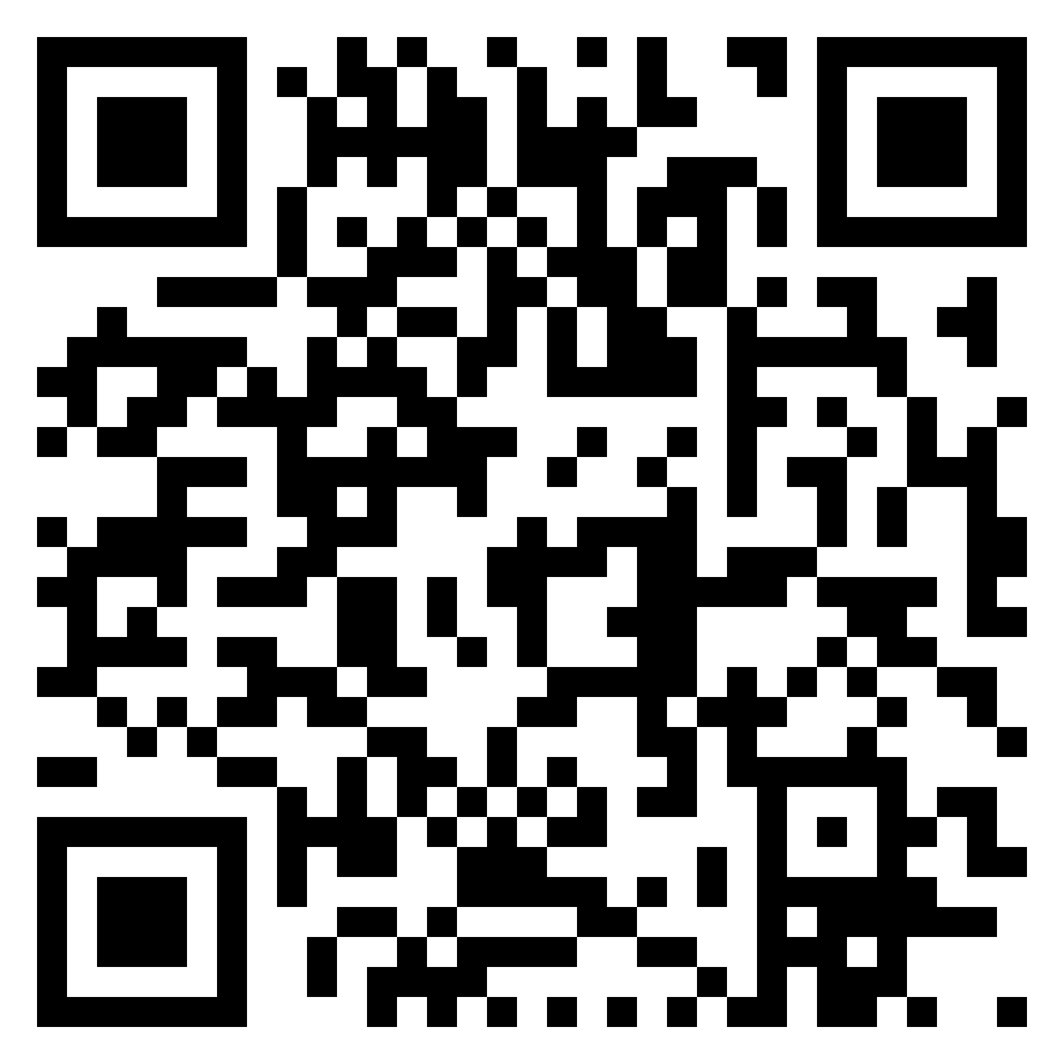

DailyPay Introduction Video | Click Play to Watch
It’s Free to Join 2M+ Using DailyPay
Click Here or Scan to Get Started
Click here to access video from Youtube directly

Slide 3
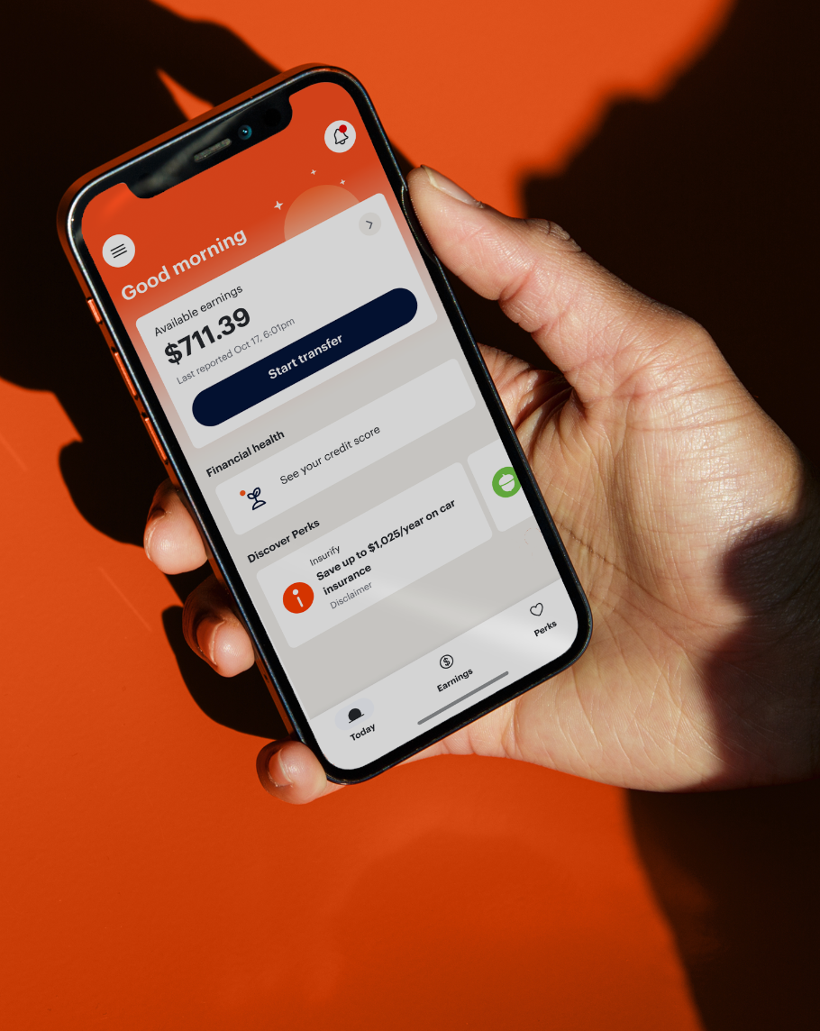
?
What is DailyPay?
Take Control of Your Pay
Included in your benefits package at no cost to you to enroll, you have access to DailyPay, which gives you access to the pay you've earned before payday and other free financial tools.
On-Demand Pay
As you work, your earnings grow and become an available balance you can transfer before payday. From controlling your cash flow to unexpected expenses, DailyPay has you covered.
✔
It’s money you’ve already earned early so, there’s no interest, repayment, or debt
Transfer instantly for less than $4 or next-business day for no-fee
Track your earnings after every shift you work
✔
✔
Your security is DailyPay's priority. Your data & information are never shared without your permission.
It’s Free to Join 2M+ Using DailyPay
Click Here or Scan to Get Started
For Connecticut residents: Due to local earned wage access regulations, these services may be unavailable or limited. For more details, please review this Help Center article.

Slide 4



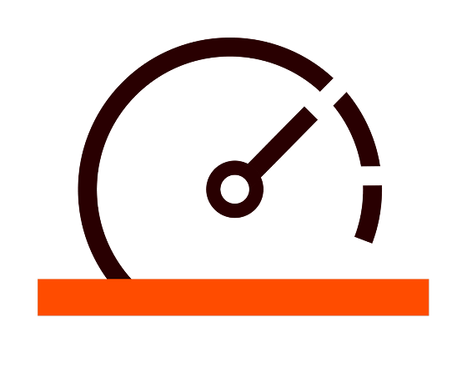


?
What are all my DailyPay benefits?
All of your Free Financial Tools. All in One Place.
On-Demand Pay
DailyPay converts pay you’ve earned into a balance you can transfer before your payday.
Discounts & Offers
Get exclusive discounted offers on essentials like gas, groceries, and more.
Pay Tracking
Stay on top of your pay by seeing how much you’ve made after every shift and with every paycheck.
Credit Monitoring
See what impacts your credit score, track your progress, and check for signs of fraud for free.
Plan & Save
Send money from your paycheck to any savings account, 100% free - no hidden fees.
Financial Coaching
Reach your goals with free, financial coaching and personalized plans to save and spend smarter.
Your security is DailyPay's priority. Your data & information are never shared without your permission.
It’s Free to Join 2M+ Using DailyPay
Click Here or Scan to Get Started

Slide 5

?
How can I sign up for DailyPay?
Sign Up Today
2M+ employees are signed up for DailyPay to access their earnings before payday
We're proud to offer DailyPay as part of your benefits package. Here’s how you can get started:
91%
of users say DailyPay is one of their top 3 most-used workplace benefits¹
Scan the QR code to sign up
Scan the QR code to go directly to app download or find us on your app store by searching ‘DailyPay’ and download the app.
72%
of users say DailyPay helps reduce their stress¹
Once the app is downloaded, you’ll complete sign up to activate your benefit - it's free to enroll there’s no catch, and it only takes a few minutes, You just need your email or phone number to sign up and get started by verifying your identity.
Prefer to use a web browser? Access DailyPay online at get.dailypay.com. Some features are only be available in the app.
90%
of users say DailyPay helps them when it comes to making decisions regarding their spending¹
Need support?
DailyPay's support team is available 24/7. Reach them anytime by phone at 866-432-0472, by
email at support@dailypay.com, or via their Help Center.
¹ DailyPay Employee Experience Research, Arizent study commissioned by DailyPay, January 2026

Slide 6

?
What happens once you enroll?
Welcome to DailyPay
Once you are enrolled and ready to use DailyPay. Here is what happens next.
Keep your personal & banking info updated in the DailyPay app at all times
Never remove or alter the DailyPay account number in your payroll system.
What happens after enrollment?
After your first transfer
Your direct deposit in your payroll system will be updated to a DailyPay bank account number.
On payday
You will receive your full paycheck, minus any earnings you transferred before payday and any associated fees during that pay period.
Note: Your bank statement may say you received a payment from Wells Fargo, PNC, or DailyPay. That is normal. DailyPay uses secure partner banks (like Wells Fargo or PNC) to safely issue payments.
It’s Free to Join 2M+ Using DailyPay
Click Here or Scan to Get Started

