Slide 1


Your guide to
getting started with
DailyPay

Slide 2

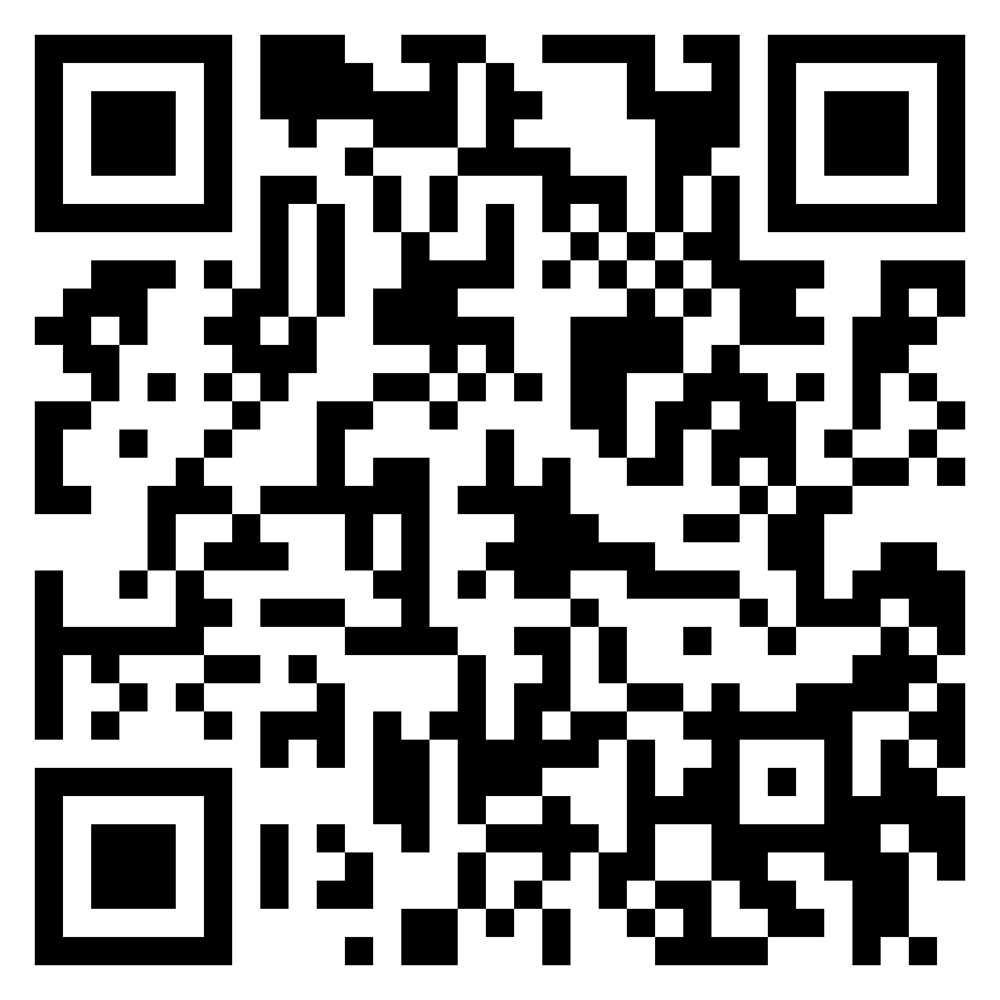

DailyPay Introduction Video | Click Play to Watch
It’s Free to Join 2M+ Using DailyPay
Scan to Get Started
Click here to view the video on Youtube

Slide 3
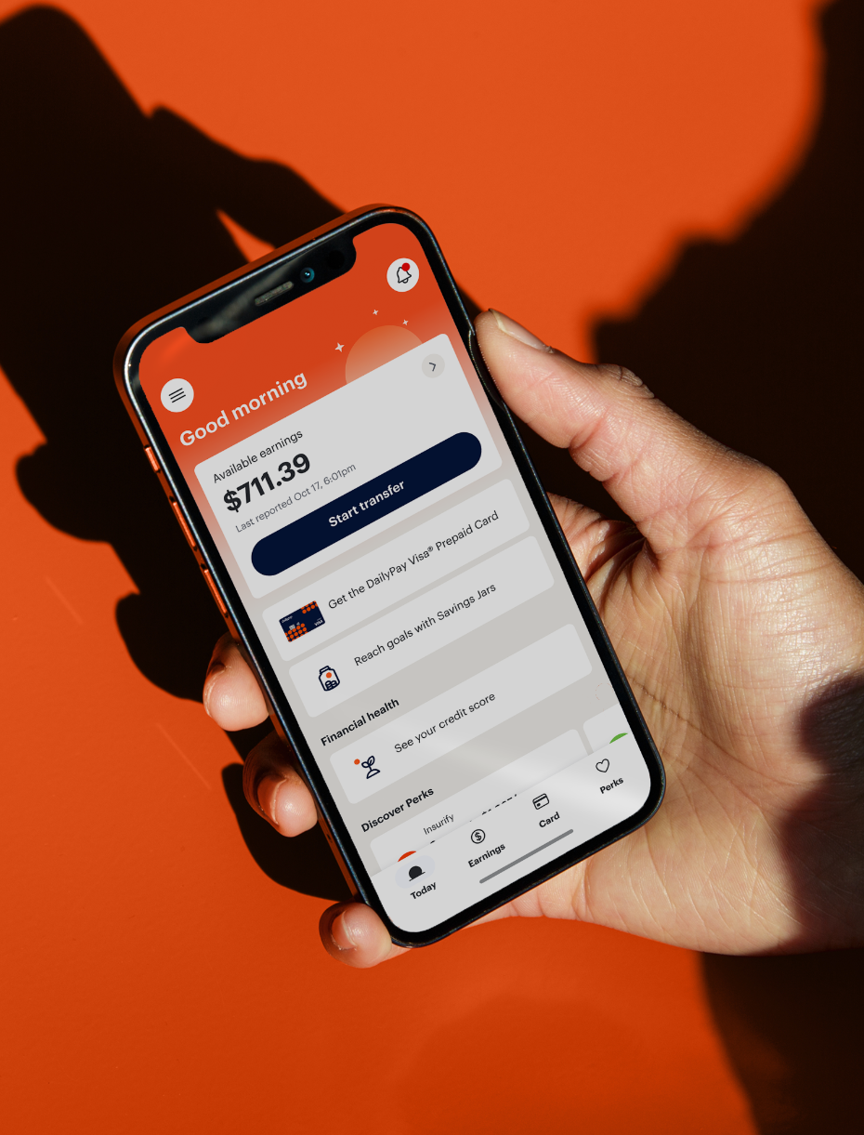
?
What is DailyPay?
It’s Free to Join 2M+ Using DailyPay
Scan to Get Started
Take Control of Your Pay
Included in your benefits package at no cost to you to enroll, you have access to DailyPay, which gives you access to the pay you've earned before payday and other free financial tools.
On-Demand Pay
As you work, your earnings grow and become an available balance you can transfer before payday. From controlling your cash flow to unexpected expenses, DailyPay has you covered.
✔
It’s money you’ve already earned early so, there’s no interest, repayment, or debt
Transfer instantly with the DailyPay Visa® Prepaid Card for no-fee*, or to any destination next-business day for free or instantly (typically $3.49 or less)
Track your earnings after every shift you work
✔
✔
Your security is DailyPay's priority. Your data & information are never shared without your permission.
*On-Demand Pay requires employer participation in DailyPay. On-Demand Pay fees will be waived for any DailyPay transfers made to a DailyPay Card set up with direct deposit. Instant Transfers may not be available to residents in all states. Please see this Help Center article for further information.
The DailyPay Visa® Prepaid Card is issued by The Bancorp Bank, N.A., Member FDIC, pursuant to a license from Visa U.S.A. Inc. and can be used everywhere Visa debit cards are accepted.

Slide 4


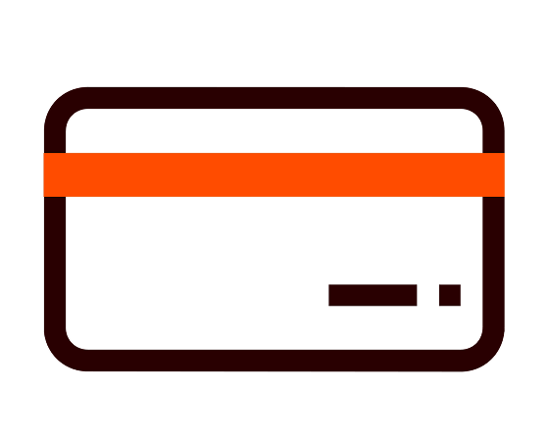

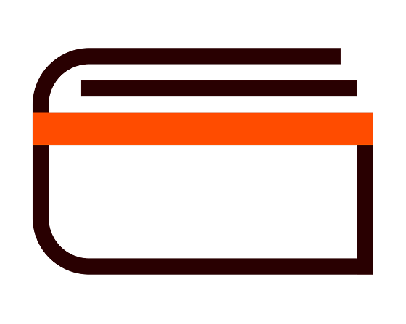




?
What are all my DailyPay benefits?
All of your Free Financial Tools. All in One Place.
On-Demand Pay
DailyPay converts pay you’ve earned into a balance you can track & transfer before your payday
DailyPay Card
Get no-fee* instant access to your earned pay and other card-exclusive free financial tools
Discounts & Offers
Get exclusive discounted offers on essentials like gas, groceries, and more
Cash Back
Earn up to 9%^{Þ} cash back¶ on everyday purchases, no fees† or points to redeem, with the DailyPay Card
Credit Monitoring
See what impacts your credit score, track your progress, and check for signs of fraud for free
Bill Manager⥮
View your repeat bills, get payment alerts, and cancel subscriptions with one-click⥮⥮ for free
Financial Coaching
Reach your goals with free, financial coaching and personalized plans to save and spend smarter
Plan & Save
Send money from your paycheck to any savings account and customized jars to save toward your goals
Your security is DailyPay's priority. Your data & information are never shared without your permission.
*On-Demand Pay requires employer participation in DailyPay. On-Demand Pay fees will be waived for any DailyPay transfers made to a DailyPay Card set up with direct deposit. Instant Transfers may not be available to residents in all states. Please see this Help Center article for further information.
^{Þ} Cash back offers are shown for illustrative purposes only. Cash back amounts vary and are subject to the individual terms of the retailer. See the DailyPay app for more information.
¶Cash Back rewards earned on qualifying purchases will generally be transferred to your Card Account within 49 days after the qualifying purchase is settled. If you close your Card Account, any earned Cash Back rewards not yet transferred to your Card Account will be forfeited. See the
DailyPay Cash Back Program Terms & Conditions for full details.
† Other Fees and limits may apply. See Cardholder Agreement for details.
⥮ Bill Manager services are provided in conjunction with a third party, ScribeUp, a DailyPay Partner. ScribeUp will only identify transactions in accounts that are integrated into the service by you. Enrollment is subject to the third party Privacy Policy and Bill Manager program terms and conditions.
⥮⥮ One click cancellation availability varies by merchant. One-click eligibility is limited to charges that Bill Manager can identify and cancel electronically through supported merchants, billing providers, or available cancellation methods.
Your funds are FDIC insured through The Bancorp Bank, N.A.; Member FDIC. DailyPay is not FDIC-insured. Deposit insurance coverage only protects against failure of The Bancorp Bank, N.A.
Free to Join 2M+ Using DailyPay
Scan to Get Started

Slide 5

?
How can I sign up for DailyPay?
Sign Up Today
2M+ employees are signed up for DailyPay to access their earnings before payday
We're proud to offer DailyPay as part of your benefits package. Here’s how you can get started:
91%
of users say DailyPay is one of their top 3 most-used workplace benefits¹
Scan the QR code to sign up
Scan the QR code to go directly to app download or find us on your app store by searching ‘DailyPay’ and download the app.
72%
of users say DailyPay helps reduce their stress¹
Once the app is downloaded, you’ll complete sign up to activate your benefit - it's free to enroll, there’s no catch, and it only takes a few minutes, You just need your email or phone number to verify your identity.
Prefer to use a web browser? Access DailyPay online at get.dailypay.com. Some features are only be available in the app.
90%
of users say DailyPay helps make decisions regarding their spending¹
Need support?
DailyPay's support team is available 24/7. Reach them anytime by phone at 866-432-0472, by
email at support@dailypay.com, or via their Help Center.
¹ DailyPay Employee Experience Research, Arizent study commissioned by DailyPay, January 2026

Slide 6

?
What happens once you enroll?
Welcome to DailyPay
Once you are enrolled and ready to use DailyPay. Here is what happens next.
Keep your personal & banking info updated in the DailyPay app at all times
Never remove or alter the DailyPay account number in your payroll system.
What happens after enrollment?
After your first transfer
Your direct deposit in your payroll system will be updated to a DailyPay bank account number.
On payday
You will receive your full paycheck, minus any earnings you transferred before payday and any associated fees during that pay period.
Note: Your bank statement may say you received a payment from Wells Fargo, PNC, or DailyPay. That is normal. DailyPay uses secure partner banks (like Wells Fargo or PNC) to safely issue payments.
It’s Free to Join 2M+ Using DailyPay
Scan to Get Started

